Slide 1
Direct3d11 Renderer
William Little

Slide 2

Purpose
Industry skills
C++, 3D Rendering
2) Impressive Project

Slide 3
Demo

Slide 4
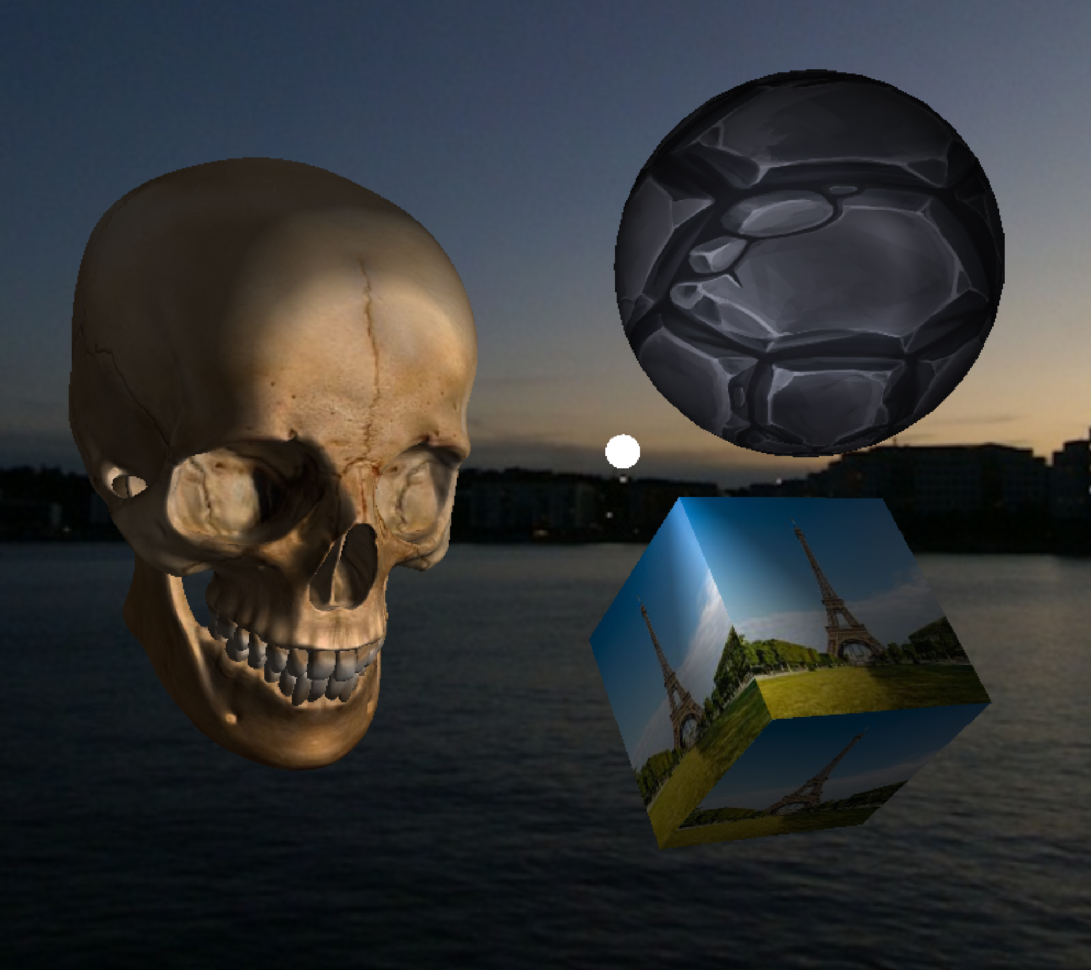
Project Overview
CPU
GPU
Display
C++
Program
Logic
HLSL Shaders
Data Processing

Slide 5

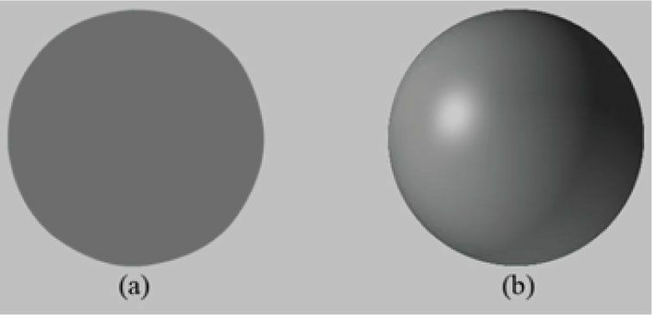
“Tricks” to 3d
Perspective
Lighting

Slide 6
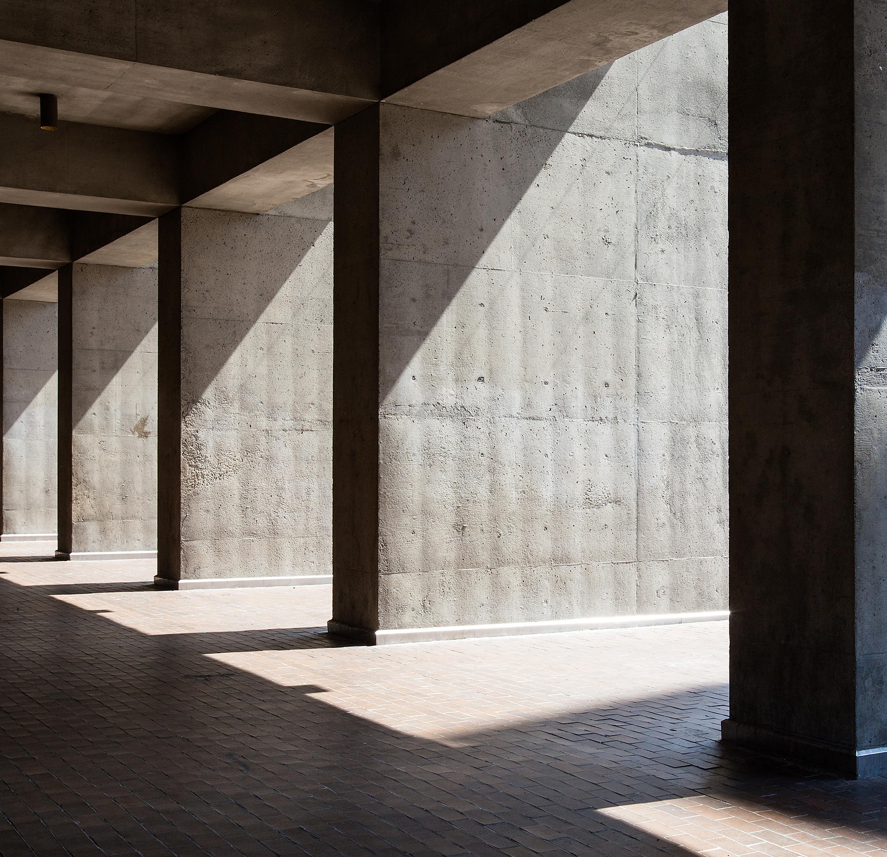
Pillars
Application
Vertex Shader
Pixel Shader

Slide 7

Application
Takes input
Makes Decisions
Loads Models / Scene

Slide 8
Pillars
Device
Context
Swap Chain
Vertex Shader
Pixel Shader

Slide 9

Device
The ID3D11Device interface is used to check feature support and allocate resources.

Slide 10
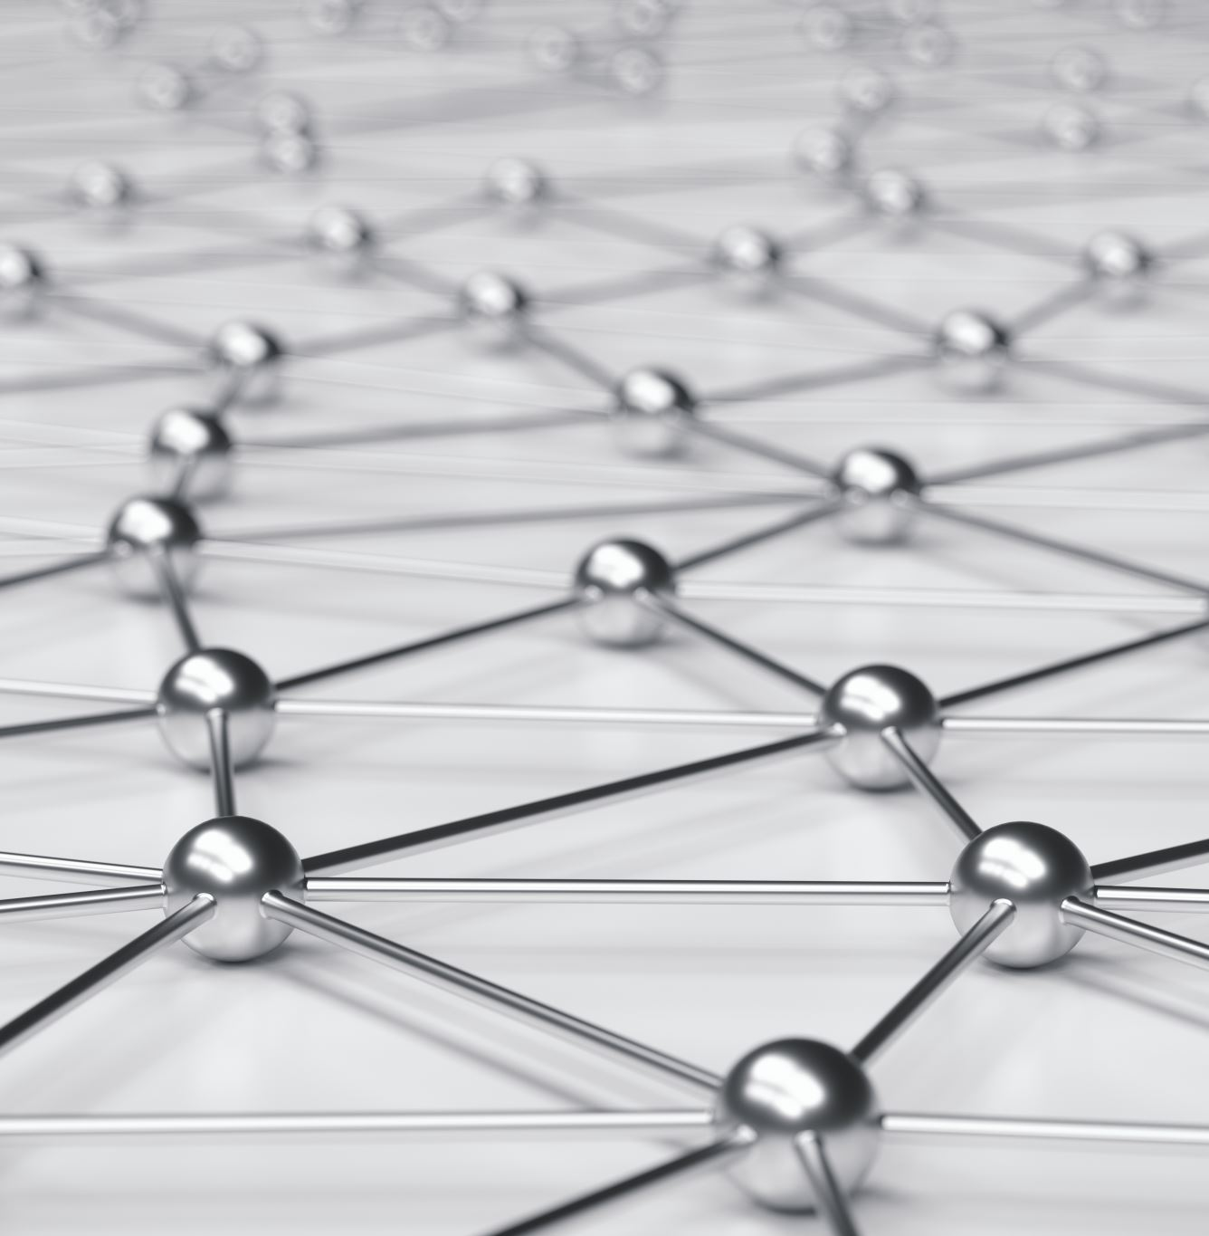
Context
The ID3D11DeviceContext interface is used to set render states, bind resources to the graphics pipeline, and issue rendering commands.

Slide 11
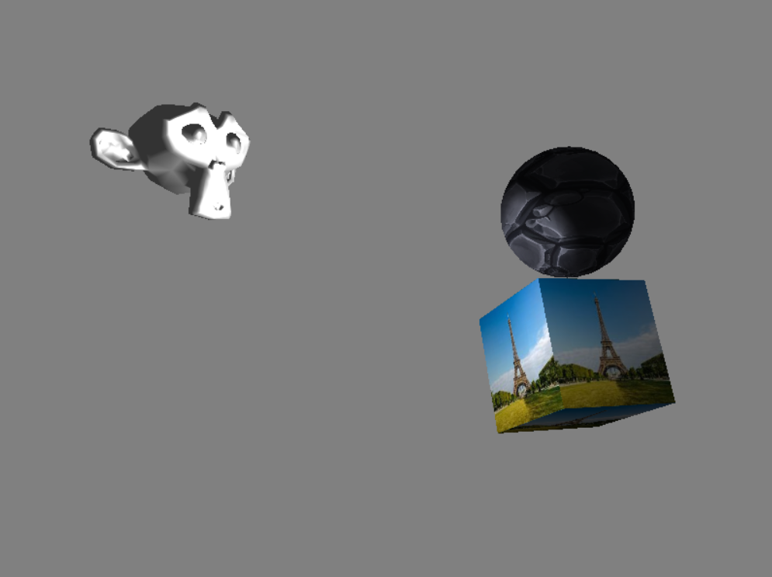
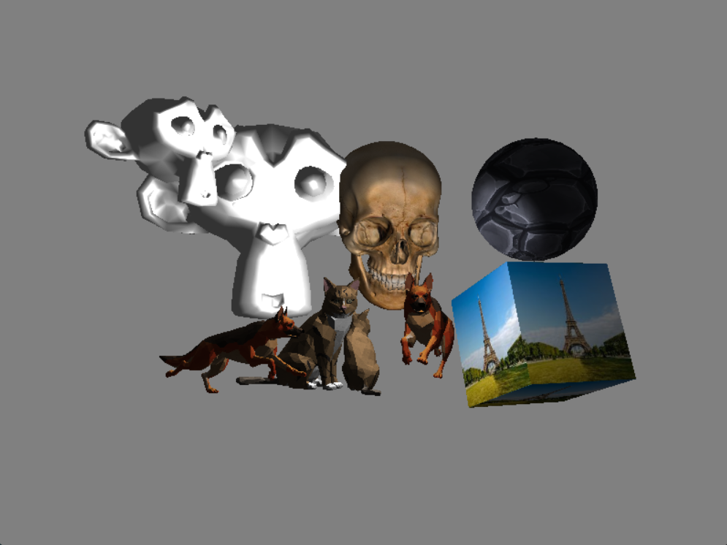
Double Buffering

Slide 12
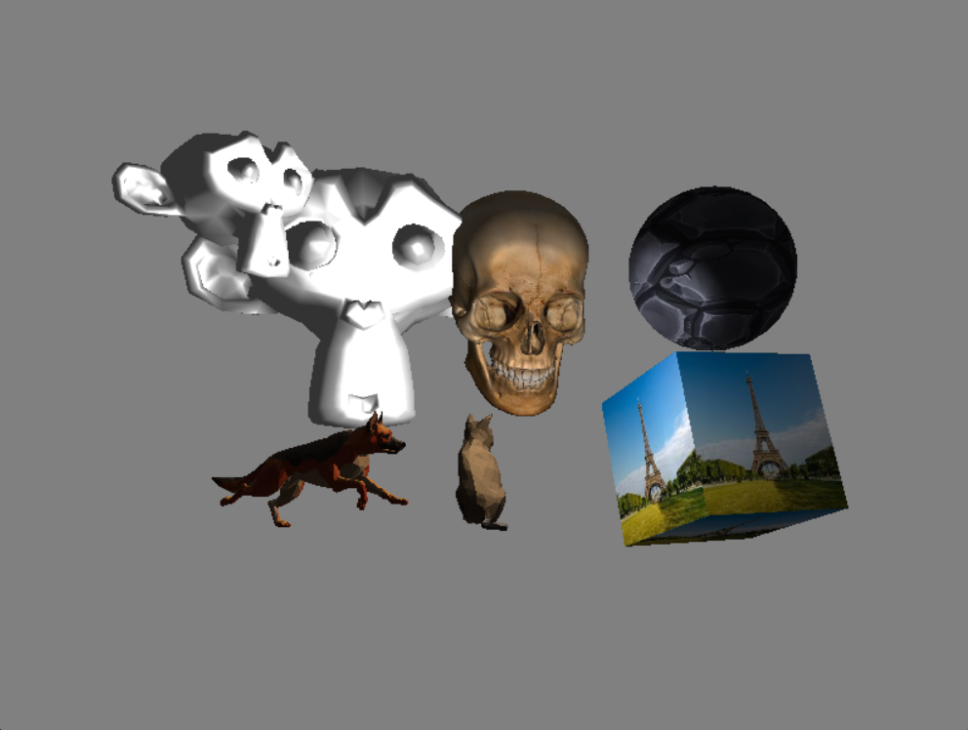
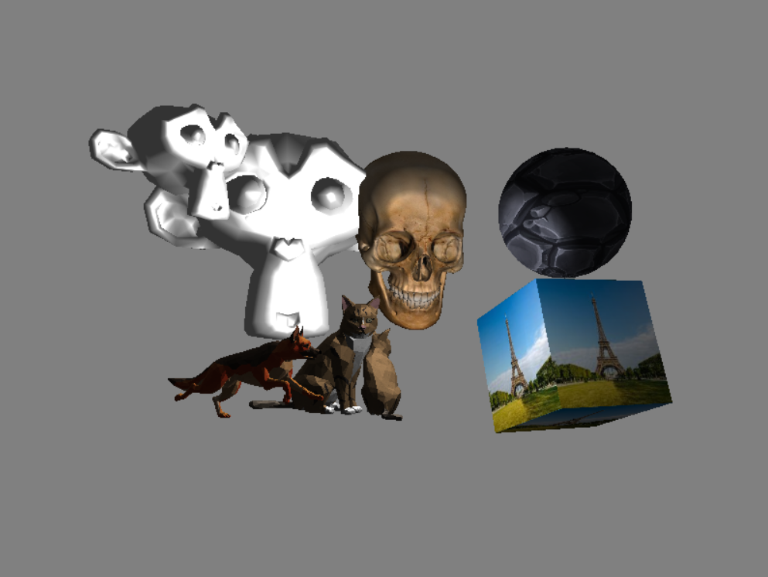
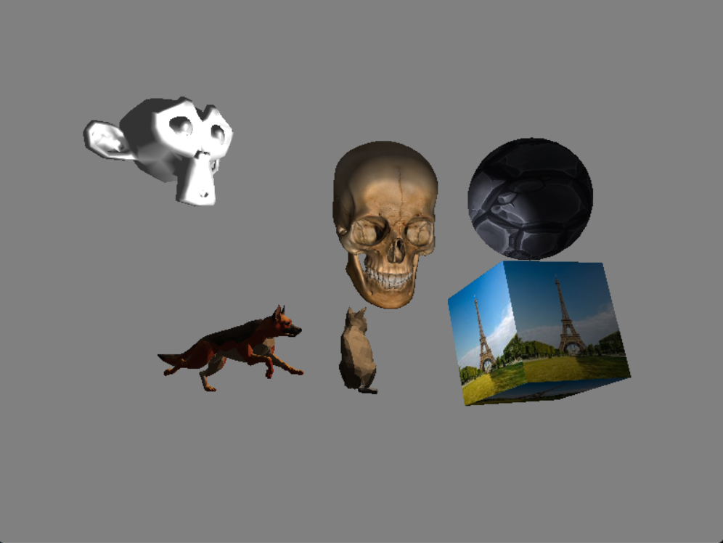
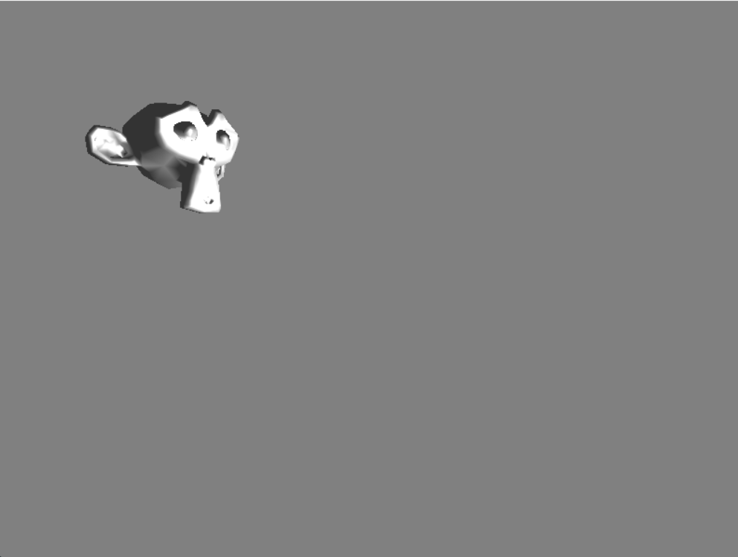
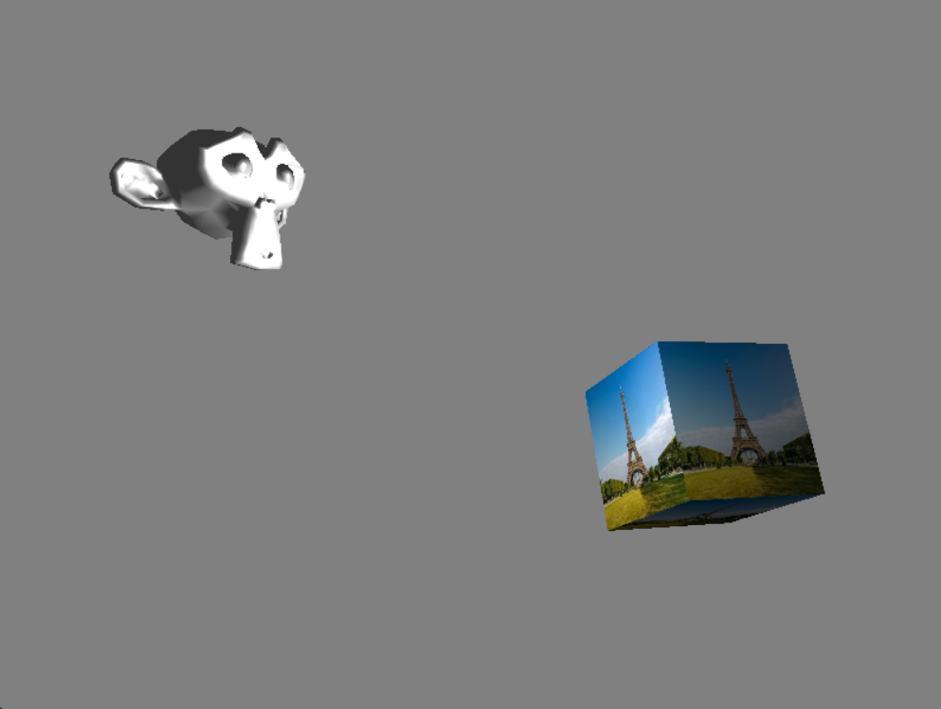
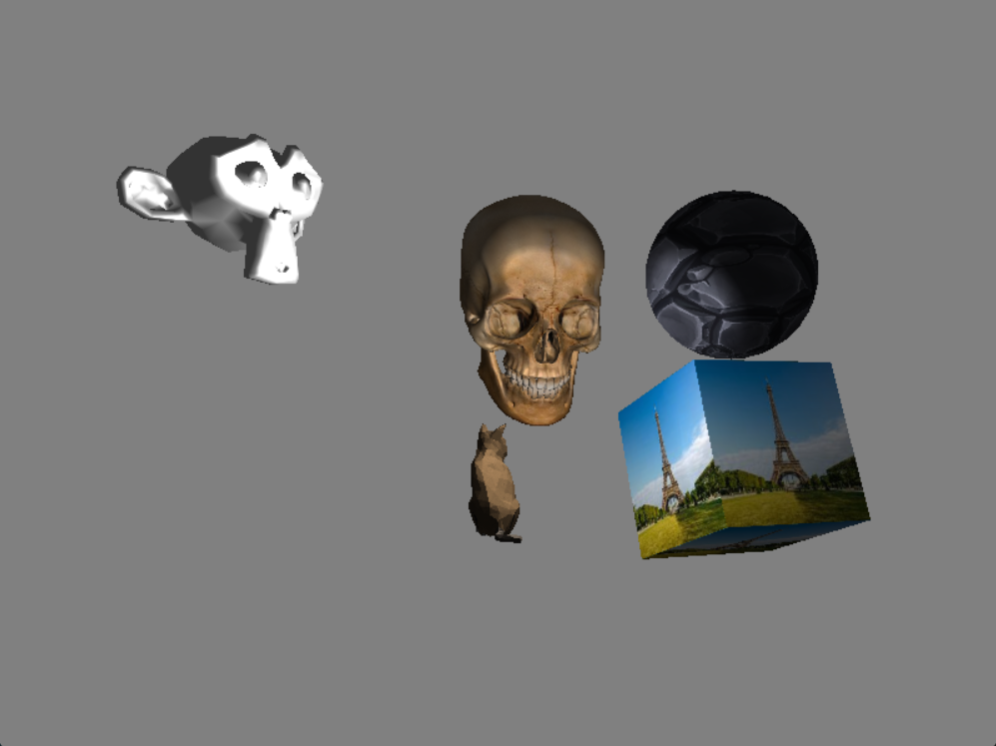
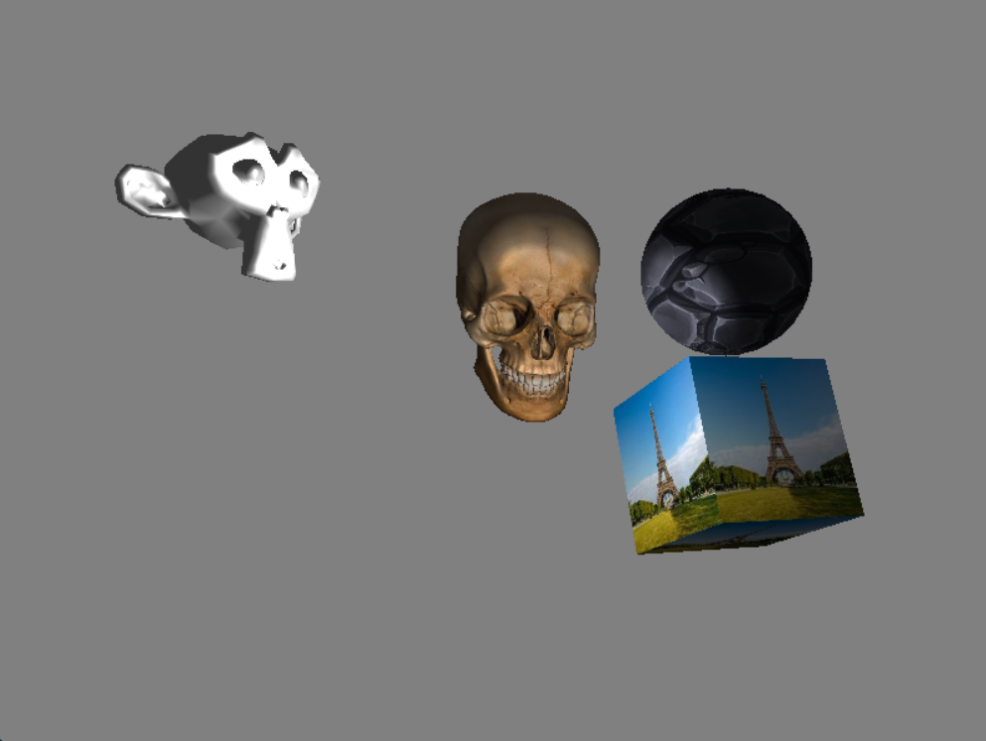
Swap Chain

Slide 13
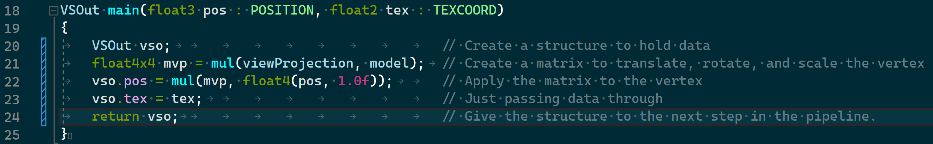
What is a Shader?
A simple program (in HLSL) which take an input, processes it, and gives an output.

Slide 14
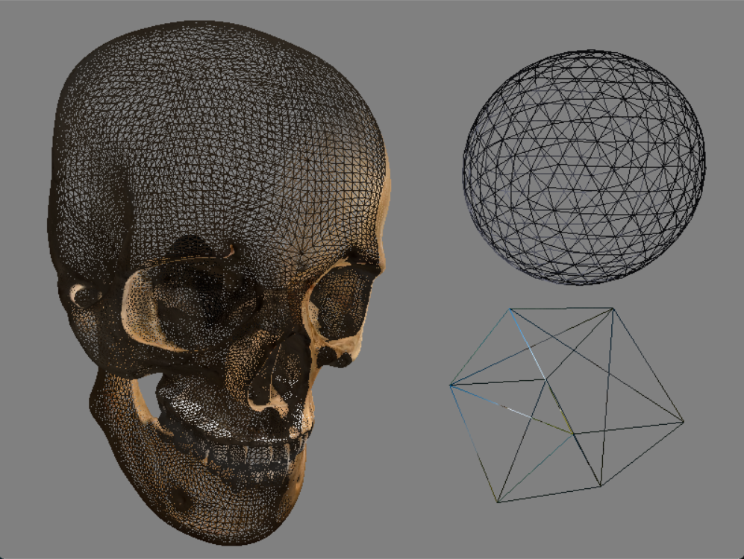
Vertex Shader
The vertex shader processes vertices
Translates, rotates, and scales vertices to build the perspective view

Slide 15
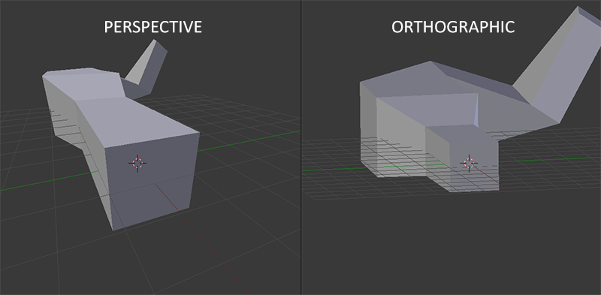
Vertex Shader
Objects are created and stored in local space.
They need to be moved to world space, then view space, then projection space.

Slide 16
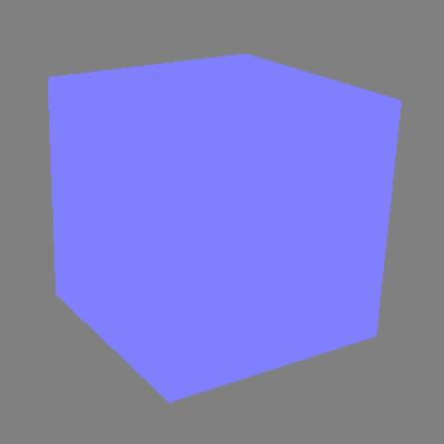
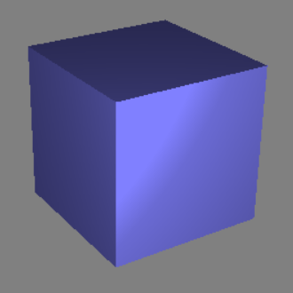
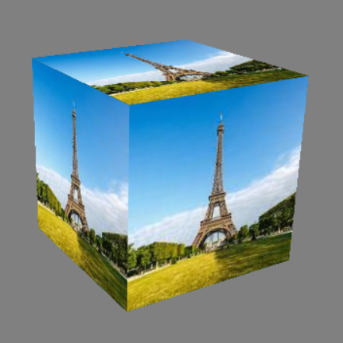
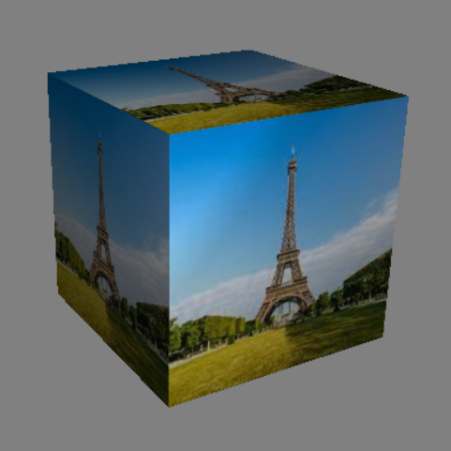
Pixel Shader
Determines color based on:
Texture
Lighting

Slide 17
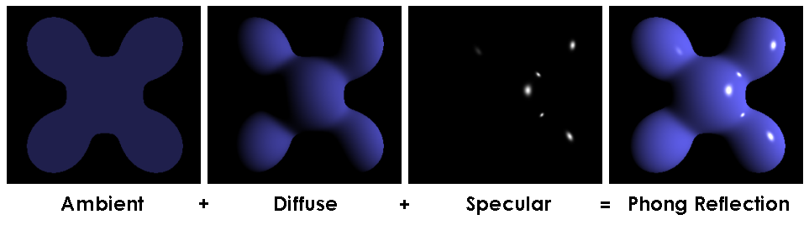
Phong Lighting
Developed by
Bui Tuong Phong

Slide 18
Technologies
Project Technologies
Development Tools
Visual Studio
Visual Studio Graphics Analyzer
RenderDoc
Technology | Usage
C++ | Main programming language
Direct3D11 | Rendering API
HLSL | Graphics programming language
Technology |  | Usage
Visual Studio |  | Code Editor / Compiler
VS Graphics Analyzer |  | Graphics Debugger
RenderDoc |  | Graphics Debugger

Slide 19
Reflection
Struggles
Direct3D11 documentation
Steep learning curve
What went well:
Help from those who know

Slide 20
Conclusion
Much more confident in C++ & rendering pipeline.
If I did it again, I would use OpenGL & include ImGui.
Plans:
Simplify and document for an example project
OR
Build into a more useful engine / tool

Slide 21
Other Features
Load multi-mesh 3D Models (vertices, uv maps, normals)
Load textures
Render models with textures
Clear color
Skybox
Scenes
Phong lighting
Copy models
Transform models
Translate and rotate camera
Reload scene at runtime
Save scene to file
Delete models

Slide 22
Thank you
Questions?

